Slide 1
Business
Intelligent
Assignment

Slide 2
Introduction
As a Junior Business Analyst at Mega Ace Software Solution Company, your primary tasks will revolve around educating business leaders on the value of data and information and developing tailored solutions to meet their needs.
In this job, you will be in charge of giving presentations to business leaders about how application software may help with decision-making and the importance of BI tools and technologies. You will also be entrusted with designing BI solutions for small enterprises as needed.

Slide 3
Table of Content
Business process
Support process
Interaction between processes
Decision making level
Comparing top 3 level
Business intelligent
Tools for business intelligent
Compare unstructured and semi-structured data
Key characteristic and functionality
Data Visualization
Self-Service Analytics
Predictive Analytics
------------------------------------
Advantage and disadvantage of Power Bi
Information System and technologies of 3 level
Comparison
Reference link

Slide 4
01
Business Process

Slide 5
Business Process
A business process is a set of interrelated actions, activities, and stages that a company does in order to reach a given objective or conclusion.
These procedures are intended to simplify operations, improve efficiency, and assure uniformity in how activities are carried out inside a company.
Business processes may be as simple as order processing or as complicated as product development or financial analysis.

Slide 6
This process involves receiving, verifying, and fulfilling customer orders. It includes steps such as order entry, payment processing, inventory checking, and shipping. An example of a reference link might be Shopify's post on "Order Processing Best Practices": HTTPs://www.shopify.com/enterprise/order-processing
Employee onboarding is the process of integrating new employees into a company. It entails duties such as documentation completion, orientation, training, and responsibility assignment. An example of a reference link might be HR Technologist's post on "Effective Employee Onboarding Strategies":
https://www.hrtechnologist.com/articles/onboarding/5-effective-employee-onboarding-strategies/
Business Process
Example

Slide 7
02
Support process

Slide 8
Support Process
A real-world support process is an organized set of activities and processes meant to give assistance, direction, or resolution to individuals, customers, or businesses dealing with difficulties, concerns, or challenges in a variety of circumstances.
Organizations often employ these procedures to provide a consistent and efficient approach to meeting user demands, improving customer happiness, and sustaining overall operational excellence.
Customer service, technical support, healthcare, education, and many more fields all use support procedures.

Slide 9
Customer Service Support Process: A customer service support process in the context of an e-commerce platform includes stages such as answering customer enquiries, troubleshooting difficulties, giving product information, and addressing complaints. This procedure guarantees that consumers receive prompt and correct support, resulting in increased customer satisfaction and retention.
https://www.zendesk.com/guides/customer-service-process/
A technical support method is designed to assist users with technical issues that arise while utilizing products or services. This procedure often entails diagnosing problems, providing step-by-step instructions, and, if required, escalating concerns to higher-level technical specialists.
https://www.cisco.com/site/us/en/index.html
Support Process
Example

Slide 10
Decision Making Level
Business intelligence (BI) refers to a set of tools, procedures, and technologies that help in the collection, analysis, and presentation of data to enable informed business decisions.
Different levels of a company require different sorts of business information assistance for effective decision-making.
Let us evaluate the many sorts of business decision-making help provided through BI at various levels inside an organization:

Slide 11
Top 3 Level
Operational Level
Tactical Level
Strategic Level

Slide 12
Compare Top 3 Level
Operational Level | Tactical level | Strategic level
The emphasis at the operational level is on day-to-day operations and transactions. | Medium-term planning and resource allocation are involved in tactical decision-making. | Strategic decisions affect the organization's long-term trajectory.
Real-time decision-making is enabled by operational BI for operations like as inventory management, order processing, and customer service. Dashboards and reports offer information about current performance measures. | Tactical BI provides more advanced analytics, allowing managers to study trends, patterns, and historical data to determine resource allocation, personnel levels, and marketing strategy decisions. | Strategic BI entails in-depth market trend research, competition intelligence, and scenario planning. Data mining and predictive analytics are tools that aid in strategic decision-making.

Slide 13
Business Intelligent
The tools, procedures, and practices that enable businesses to collect, analyze, and provide meaningful insights from their data are referred to as business intelligence (BI).
By translating raw data into relevant information, visualizations, and reports that support strategic, tactical, and operational decision-making, BI assists organizations in making informed decisions.

Slide 14
Example
Consider a retail corporation that wishes to improve its inventory management.
The organization may collect data on sales trends, client preferences, and seasonal patterns by applying BI.
The data is then processed by the BI system, which generates visual dashboards and reports that reveal which products are selling well, when demand surges occur, and which things are slow-moving.
With this information, the corporation may more efficiently satisfy client requests by adjusting inventory levels, planning promotions, and streamlining supply chain processes.

Slide 15
Tools For Business Intelligent
Business intelligence (BI) tools are software programs and platforms that help businesses collect, analyze, visualize, and report data to assist decision-making.
These tools let users turn raw data into meaningful insights and offer a variety of functions for data exploration, reporting, and collaboration.

Slide 16
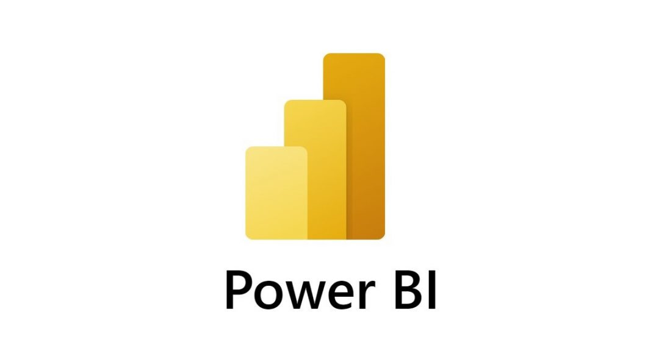
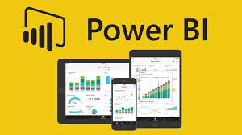
Example
Microsoft's Power BI is a well-known BI product.
It enables users to connect to a variety of data sources, such as databases, spreadsheets, and cloud services. Using Power BI's drag-and-drop interface, users can then build dynamic and aesthetically attractive dashboards, reports, and data visualizations.
These visualizations aid users in understanding data trends, patterns, and correlations, allowing them to make more educated business decisions.

Slide 17
Compare Unstructured data and semi-structured data
 | Unstructured | Semi-structure
Nature | Data that lacks a preset structure, making analysis more difficult. | Has some organization, making it easier to analyze than unstructured data.
Process | For meaningful analysis, sophisticated techniques such as NLP are required. | Can be processed by combining parsing and querying.
Insights | Insights on attitudes, views, and trends are provided | Provides insight into trends, linkages, and usage patterns.
Example files | Customer reviews, social media comments, and photographs | XML files, JSON data, and application logs

Slide 18
Key Characteristic and functionality
Self-Service Analytics
Data Visualization
Predictive Analytics
01
02
03

Slide 19
Data Visualization
Key Characteristic
How it support decision making
Illusion
Data visualization is the presentation of data in graphical or visual representations, making complicated information easier to grasp and evaluate.
A retail corporation employs business intelligence technologies to generate dynamic dashboards that display sales data over time, broken down by product, location, and customer group. Bar charts, line graphs, and heat maps give a clear picture of sales patterns, assisting managers in identifying high-performing goods and areas for development.
Managers can rapidly spot trends, outliers, and correlations in data. This data assists in making sound judgments about inventory management, marketing tactics, and resource allocation.

Slide 20
Self-Service Analytics
Key Characteristic
How it support decision making
Illusion
Self-service analytics enables non-technical users to independently access and analyze data, minimizing reliance on IT professionals.
A hospital institution delivers self-service BI tools to its clinicians and managers. Doctors may access patient data to track treatment outcomes, and managers can compile hospital performance reports without the need for IT help.
Self-service analytics speeds up decision-making by providing users with real-time data and insights suited to their specific requirements, hence enhancing patient care and operational efficiency.

Slide 21
Predictive Analytics
Key Characteristic
How it support decision making
Illusion
Predictive analytics includes forecasting future patterns and outcomes using historical data and statistical algorithms.
BI is used by an e-commerce firm to examine historical sales data, consumer behavior, and external factors such as weather and holidays. The corporation can project revenues for the following months and alter inventory and marketing strategy accordingly by using predictive analytics.
Predictive analytics reduces risks by offering insights into possible obstacles and opportunities, allowing businesses to plan for swings in demand and make proactive decisions.

Slide 22
Advantage and disadvantage of Power Bi
Advantages
Disadvantages
User-Friendly Interface: Power BI has a drag-and-drop interface that allows users with various technical skills to generate data visualizations and reports.
Data Transformation: Power BI has powerful data transformation tools that allow users to clean, shape, and model data before analyzing it to ensure correct insights.
Data Visualization: With a large collection of visualizations, Power BI enables users to construct engaging and interactive dashboards that effectively deliver information.
Cost: While Power BI has a free version, more sophisticated features and capabilities need subscription plans, which may be prohibitively expensive for some enterprises.
Despite its user-friendly design, grasping Power BI's complex capabilities and functions may necessitate some study and training.
Limited Offline Access: The free version's offline access capacity is limited, requiring users to maintain an active internet connection for real-time updates.

Slide 23
Information System and technologies of 3 level
Operational Level Information Systems | Tactical Level Information Systems | Strategic Level Information Systems
TPS (Transaction Processing Systems): Automation and assistance of operational procedures and transactions. Process structured data in great volume and at fast speed. Point-of-sale systems are an example. | Office Automation Systems (OAS): Their purpose is to help with day-to-day office operations and communication. Tools for email, word editing, and spreadsheets are among the features. Microsoft Office Suite is one example. Decision Support Systems (DSS): Their purpose is to help managers make semi-structured decisions. Data analysis and modeling tools are among the features. Consider what-if analysis tools. | Executive Information Systems (EIS): Provide high-level summaries to senior executives. Features include customizable dashboards and strategic data. Executive dashboards are one example. Business Intelligence Systems (BI): Gather, analyze, and display data to support strategic choices. Data warehousing and advanced analytics are two characteristics. Tableau and Microsoft Power BI are two examples.

Slide 24
Comparison for Top 3
Scope: Operational systems handle day-to-day transactions, tactical systems help managers make choices, and strategic systems help with long-term planning.
Data Complexity: Operational systems deal with structured data, whereas tactical and strategic systems deal with semi-structured data.
User Level: Operational workers utilize operational systems, intermediate managers use tactical systems, while senior executives use strategic systems.
Decision Support: Operational systems are concerned with routine decisions, tactical systems are concerned with semi-structured decisions, and strategic systems are concerned with long-term strategies.

Slide 25
THANK YOU FOR YOUR ATTENTION

